Slide 1
Clickstream Customer Conversion
K. shanmugapriya

Slide 2
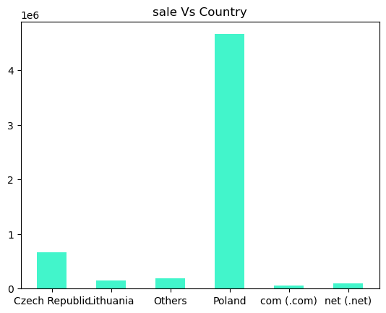
Sale across the countries

Slide 3
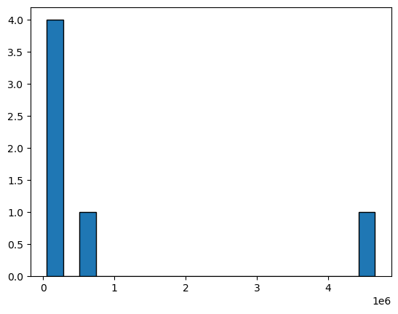
Price Vs Price

Slide 4
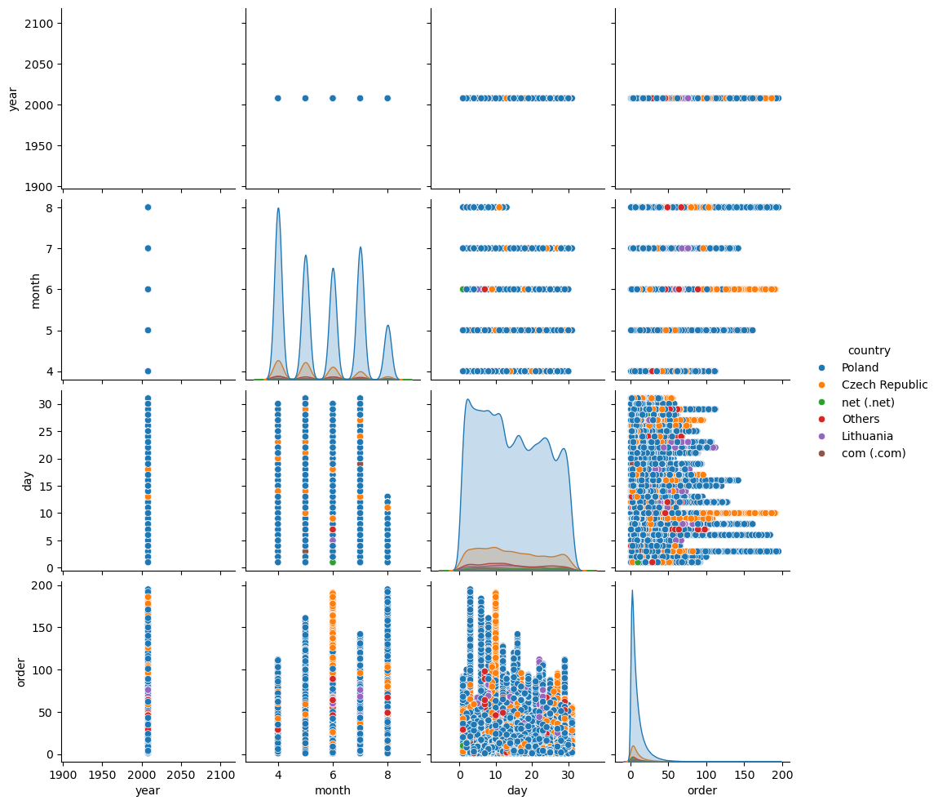
Pairplot for year,month,day,order over countries

Slide 5
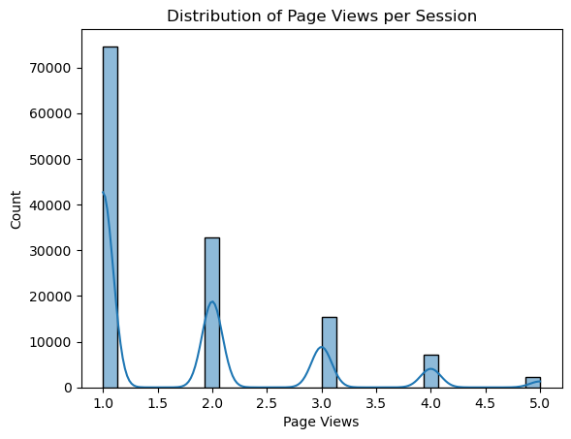
Page view per session

Slide 6
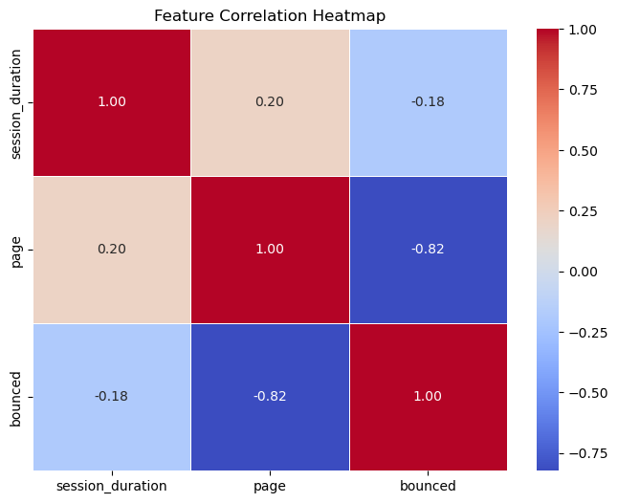
Analyze session duration, page views, and bounce rates

Slide 7
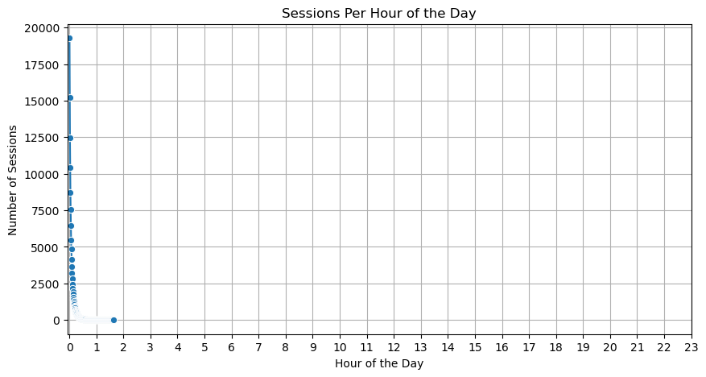

Slide 8
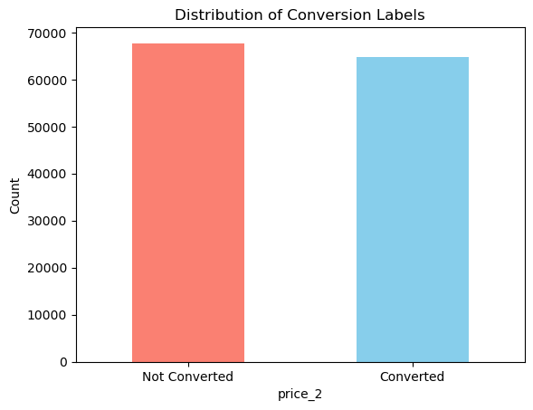
Checking for inbalance

Slide 9
The End

